Slide 1


Functional programming in concurrent and distributed systems
381-1-0112 | SM B 2019 | Tutorial 7
David Leon

Slide 2
Outline
Run-time Errors
Exceptions
Exceptions: Errors
Exceptions: Exits
Exceptions: Throws
try … catch
Example
Submission Procedures

Slide 3
Run-time Errors
1> lists:sort([3,2,1]).
[1,2,3]
2> lists:sort(fffffff).
** exception error: no function clause matching lists:sort(fffffff)
function_clause
case_clause
if_clause
undef
3> case "Unexpected Value" of
3> expected_value -> ok;
3> other_expected_value -> 'also ok'
3> end.
** exception error: no case clause matching "Unexpected Value"
4> if 2 > 4 -> ok;
4> 0 > 1 -> ok
4> end.
** exception error: no true branch found when evaluating an if expression
7> lists:random([1,2,3]).
** exception error: undefined function lists:random/1

Slide 4
#1 Exceptions
Logical errors may happen more than we expect them to take place
Provoking run-time crashes may be used to spot errors early
There are three kinds of exceptions in Erlang
Errors
Throws
Exits

Slide 5
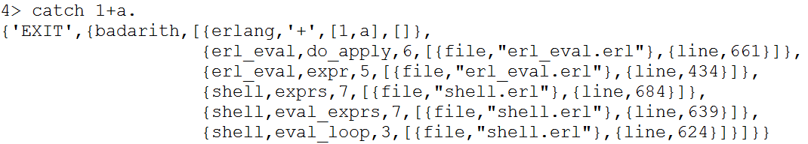
#1.1 Exceptions: Errors
erlang:error(Reason)
Stops the execution of the calling process with the reason Reason
Returns {Reason, Where}
Where is a list of the functions most recently called (current function first)

Slide 6
#1.2 Exceptions: Exits
erlang:exit(Reason)
Stops the execution of the calling process with the reason Reason
Returns Reason
The difference from erlang:error/1 is in the intent
error/1 is called when an error ‘simply’ occurs
exit/1 is called when a condition worthy of killing the current process is fulfilled

Slide 7
#1.3 Exceptions: Throws
erlang:throw(Any)
A non-local return from a function
If evaluated within a catch, catch will return the value Any
Used in cases that the programmer can be expected to handle
Used to manage the control flow
Example: array module Consider a lookup function that can return a user-supplied default value if it can't find the element needed. When the element can't be found, the value default is thrown as an exception, and the top-level function handles that and substitutes it with the user-supplied default value. This keeps the programmer of the module from needing to pass the default value as a parameter of every function of the lookup algorithm.

Slide 8
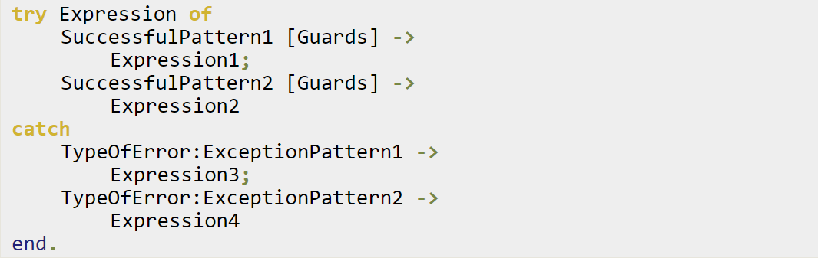
#2.1 try ... catch
A way to evaluate an expression while letting the programmer handle the successful case as well as the errors encountered
Any kind of exception happening within Expression will be caught.

Slide 9
#2.1 try ... catch
The patterns and expressions returned from Expression behave in exactly the same manner as a case…of
TypeOfError can be replaced by either error, throw, or exit
If no type is provided, a throw is assumed.

Slide 10
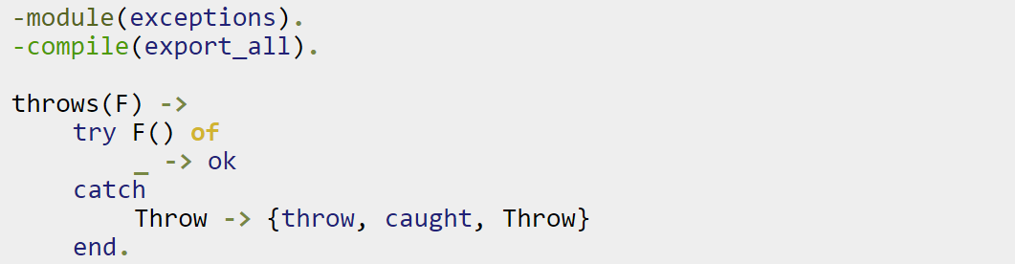
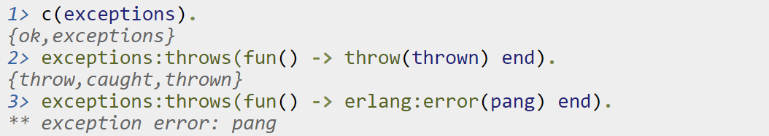
#2.2 try ... catch: Example
We can compile it and try it with different kinds of exceptions:

Slide 11
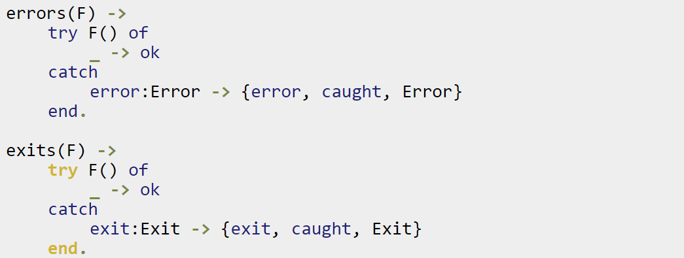
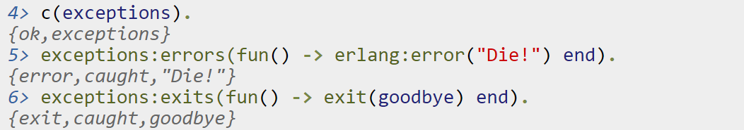
#2.2 try ... catch: Example
Code:

Slide 12
#3 Submission Procedures
Only a single .erl file to be submitted
Filename format: ex7_<ID>.erl
Where <ID> needs to be replaced with your ID number
Your code MUST be well documented
Functions’ names must be identical to the ones defined in exercise
Same as for the arity
Same as for the output format
Only the tested functions needs to be exported
Internal functions MUST NOT be exported
Assignments will be tested automatically in using Erlang shell in Linux
No excuses

Slide 13
Exercise 7
steady(F)
Evaluates function F and logs all its exceptions
Exception handling procedures
error:Error returns {Time, error, Error}
exit:Exit returns {Time, exit, Exit}
throw:Throw returns {Time, throw, Throw}
All exceptions must be logged (appended) in a file named “myLog_<ID>.elog”
Do not use fwrite function, use io:format.
File needs to be saved in current directory
Successful returns need to be logged, too
{Time, success, ReturnValue}
Use Time from os:system_time().
calc(division,A,B)
Implement only the division operator of calc module (Practice slide #2)
Protect case of divided by zero with try and catch.

